Slide 1
INFO5100 FINAL PROJECT PRESENTATION
TEAM SKS -
Karthik Vanabhojana 002297746 | Shreyas H Patil 002843937 | Shreyas S Sreedhar 002874944

Slide 2
CONTENTS
PROBLEM STATEMENT
STAKEHOLDER & CONTRIBUTIONS
USE CASES
DESIGN AND IMPLEMENTATION

Slide 3
Problem Statement
The current healthcare system is fragmented, inefficient, and frustrating for both patients and providers. Patients face long wait times, complex administrative tasks, and limited access to healthcare services. Providers struggle with overwhelming workloads, outdated technologies, and lack of real-time data insights.Patients who live away from the cities or do not have the modes of transport cannot always go to the Specialist Clinic or Doctors.

Slide 4
Problem Solution
MHelp is a Healthcare Management System that aims to develop a comprehensive healthcare management platform that streamlines the patient journey from sign-up to receiving treatment and medication. Currently, the healthcare system suffers from fragmented processes and inefficiencies, leading to frustration for both patients and providers. MHelp addresses these challenges by:
Simplified Onboarding: Streamlined registration, pre-populated information for all Roles
Virtual Doctor Consultations: Easy Appointment management, and secure communication with doctors.
Streamlined Diagonosis and Treatment: Integration with diagnostic labs and tools.
Medication Delivery: Integration with the Pharmaceutical companies to ensure smooth delivery of medicines with tracking.

Slide 5
STAKEHOLDER & CONTRIBUTIONS
Patients: MHelp empowers patients by providing user-friendly access to their medical records, convenient virtual consultations with doctors, secure communication channels, and educational resources. Additionally,MHelp delivers medication and lab reports directly to their homes, enhancing convenience and reducing administrative burdens.
Doctors: MHelp simplifies doctor workflows by automating administrative tasks, providing AI-powered decision support tools, and streamlining communication with patients. The platform also facilitates efficient appointment management, order tracking, and real-time data analytics, enhancing overall practice management efficiency.
Pharmacies: MHelp integrates with pharmacies to facilitate online medication prescriptions and delivery services, ensuring seamless access to medication for patients. This also creates a revenue stream for pharmacies and improves customer satisfaction.
Lab Partners: MHelp collaborates with laboratories to provide patients with convenient at-home lab testing options and integrates with their systems to facilitate secure and efficient delivery of test results.
Admin: MHelp admins have an oversight of all the things going around in the application and can either delete or update users.

Slide 6
USE CASES
Patient signs up and creates a profile: A user-friendly interface guides patients through the registration process, pre-populating relevant information for a quick and seamless experience.
Patient books a virtual consultation: Patients can easily schedule appointments with doctors based on their availability and preferences, eliminating long wait times at clinics.
Doctor conducts a virtual consultation: The platform provides secure video and audio conferencing tools for doctors to conduct consultations remotely, increasing patient access and reducing travel time.
Doctor prescribes medication and orders lab tests: MHelp integrates with pharmacies and lab partners,enabling doctors to electronically send prescriptions and lab orders, streamlining the treatment process.
Patient receives medication and lab results: MHelp facilitates medication delivery directly to patients' homes and provides real-time access to lab results through the platform, enhancing convenience and transparency.

Slide 7
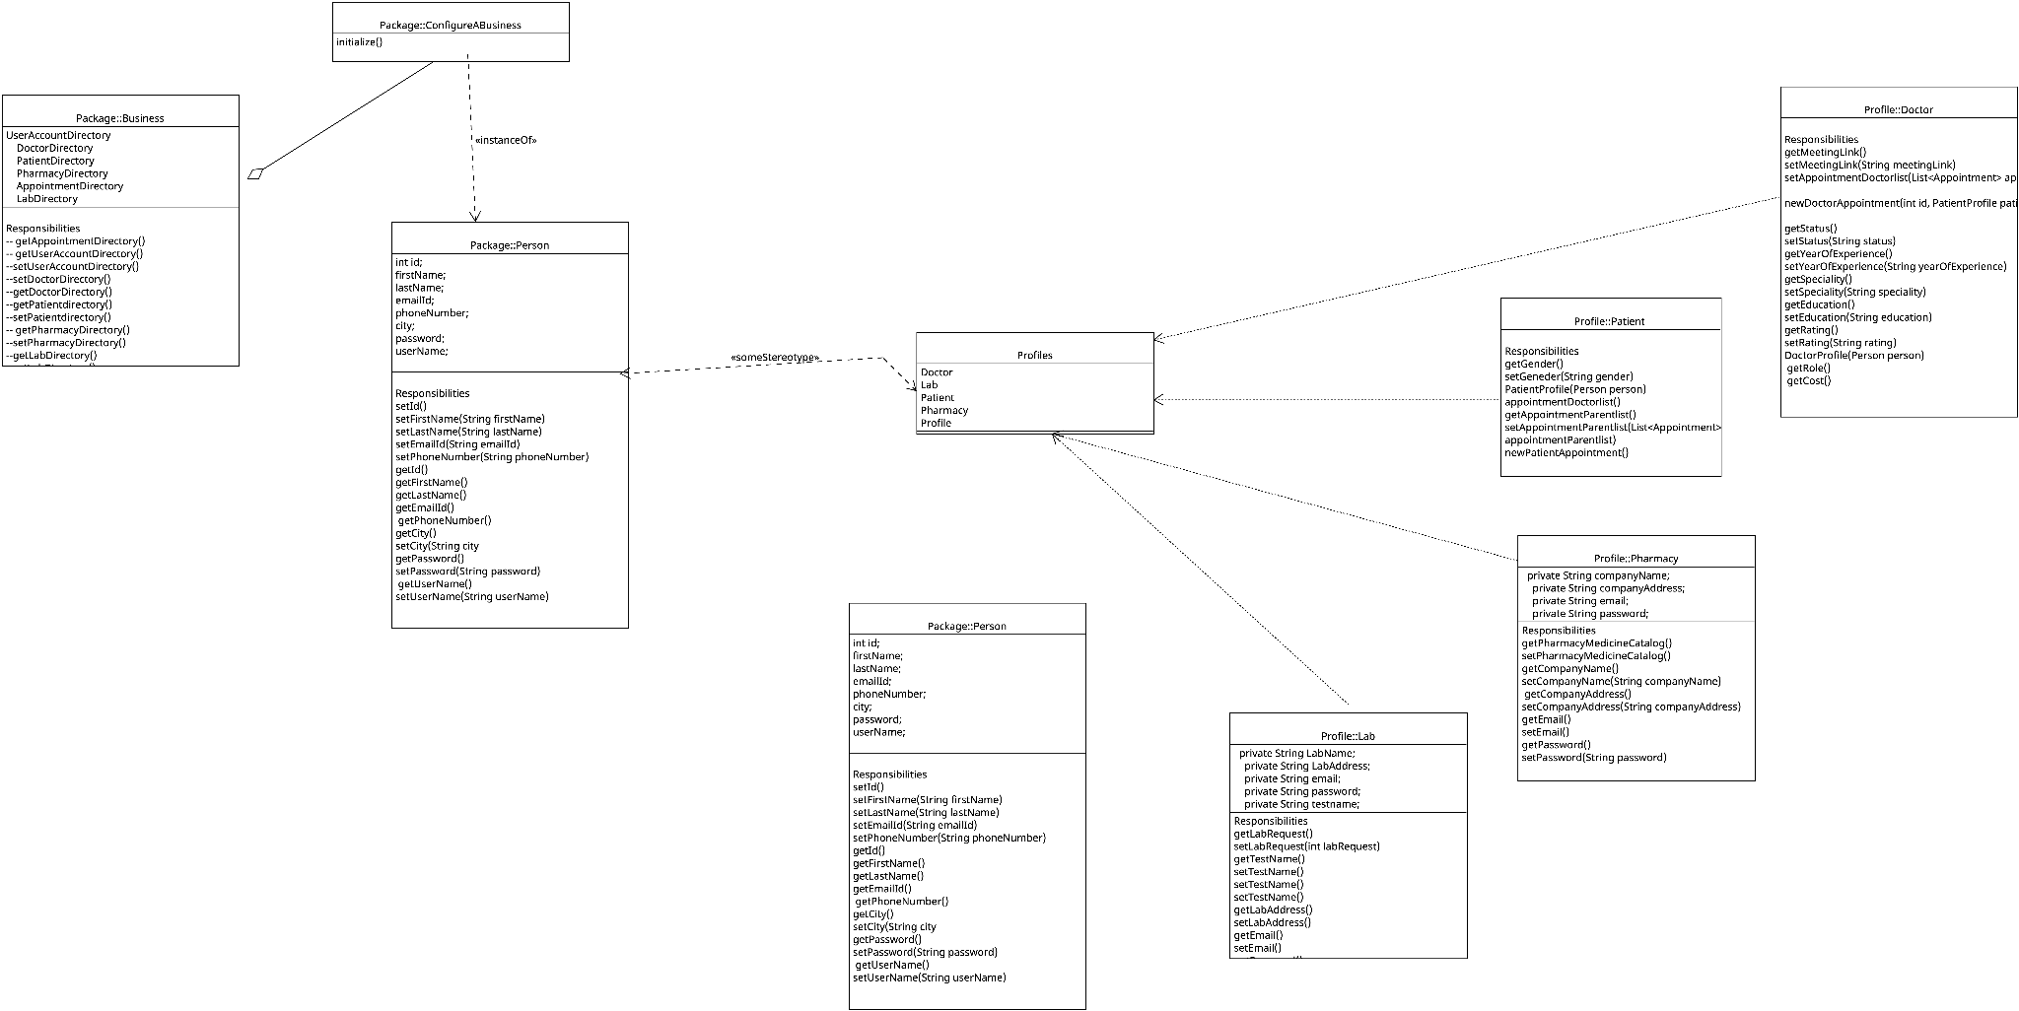
DESIGN AND IMPLEMENTATION

Slide 8
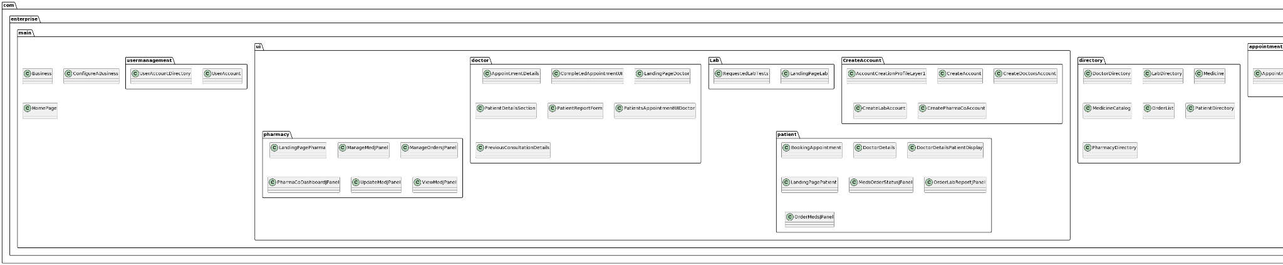
DESIGN AND IMPLEMENTATION

Slide 9
Why is Enterprise users are essential
Each enterprise involved in the MHelp ecosystem plays a vital role in delivering the total value outlined in the problem statement.
Patients: Their active participation and engagement drive platform adoption and provide valuable feedback for continuous improvement.
Doctors: Their expertise and utilization of MHelp tools contribute to improved diagnoses, efficient workflows, and enhanced patient satisfaction.
Pharmacies and Labs: Their integration and service delivery ensure seamless access to medication and lab tests, crucial for timely treatment and accurate diagnoses.
MHelp: The platform acts as the central hub, orchestrating workflows, facilitating communication, and providing valuable data insights to all stakeholders, driving continuous improvement and optimization of the healthcare ecosystem.

Slide 10
Thank you!

